Slide 1
OBSESSIVE-COMPULSIVE MOOD DISORDER TREATMENT CASE REPORT
Here is where your presentation begins

Slide 2
CONTENTS OF THIS TEMPLATE
You can delete this slide when you’re done editing the presentation
Fonts | To view this template correctly in PowerPoint, download and install the fonts we used
Used and alternative resources | An assortment of graphic resources that are suitable for use in this presentation
Thanks slide | You must keep it so that proper credits for our design are given
Colors | All the colors used in this presentation
Icons and infographic resources | These can be used in the template, and their size and color can be edited
Editable presentation theme | You can edit the master slides easily. For more info, click here
For more info:
SLIDESGO | BLOG | FAQs
You can visit our sister projects:
FREEPIK | FLATICON | STORYSET | WEPIK | VIDEVO

Slide 3
TABLE OF CONTENTS
01
02
03
04
05
About the patient
Discussion
Diagnosis
You can describe the topic of the section here
You can describe the topic of the section here
You can describe the topic of the section here
Treatment
Patient monitoring
You can describe the topic of the section here
You can describe the topic of the section here

Slide 4
IDENTIFYING INFORMATION
Mars
Jupiter
Venus
Despite being red, Mars is actually a cold place. It’s full of iron oxide dust
Jupiter is a gas giant and the biggest planet in the Solar System
Venus has a beautiful name and is the second planet from the Sun

Slide 5

PATIENT MEDICAL HISTORY
2010
Mercury
Mercury is the closest planet to the Sun
2017
Mars
Despite being red, Mars is actually a cold place
Sarah Patterson
2020
Saturn
Age: 40
Gender: Female
Allergies: None
Location: Madrid, Spain
Saturn is a gas giant and has several rings

Slide 6
REVIEW OF SYSTEMS
Mercury
Mars
Mercury is the closest planet to the Sun
Despite being red, Mars is a very cold place
Venus
Jupiter
Venus is the second planet from the Sun
Jupiter is the biggest planet of them all

Slide 7
PHYSICAL EXAMINATION
Mercury is the smallest planet of them all
Mercury
Venus is the second planet from the Sun
Venus
Despite being red, Mars is actually a cold place
Mars

Slide 8
DISCUSSION
“Neptune is the farthest planet from the Sun and the fourth-largest in the Solar System!”
—Laura Patterson
“Mercury is the closest planet to the Sun and also the smallest one in the Solar System”
—Monique Nelson
“Despite being red, Mars is a cold place. It’s full of iron oxide dust, which gives the planet its reddish cast”
—John James

Slide 9
DISCUSSION SUMMARY
Mercury is the closest planet to the Sun and the smallest one in the Solar System—it’s only a bit larger than the Moon. This planet’s name has nothing to do with the liquid metal, since Mercury was named after a Roman god

Slide 10
COMPARISON
Area | Factor A | Factor B | Factor C
Area 1 | Mars is cold | Mars is made of basalt | Mars is a red planet
Area 2 | Earth is full of water | Earth has life | We all live on Earth
Area 3 | Venus is hot | Venus has a nice name | Venus has no moons
Area 4 | Saturn is a gas giant | Saturn has rings | Saturn is quite big

Slide 11
DIAGNOSIS
Venus
Mars
Saturn
Venus is the second planet from the Sun
Mars is actually a very cold place
Saturn is composed of hydrogen and helium
Mercury
Jupiter
Neptune
Mercury the closest planet to the Sun
Jupiter is the biggest planet of them all
Neptune is very far away from the Sun

Slide 12
EXPERTS AROUND THE WORLD
Therapy
Venus is the second planet from the Sun
Medication
Mercury is the closest planet to the Sun
Neurosurgery
Despite being red, Mars is a very cold place

Slide 13
—SOMEONE FAMOUS
“This is a quote, words full of wisdom that someone important said and can make the reader get inspired.”

Slide 14
TREATMENT
Mercury
Venus
Mercury is the closest planet to the Sun and the smallest one in the Solar System—it’s only a bit larger than the Moon
Venus has a beautiful name and is the second planet from the Sun. It’s hotter than Mercury and its atmosphere is very poisonous

Slide 15
PATIENT MONITORING
Week 1
Venus is the second planet from the Sun
Week 2
Jupiter is the biggest planet of them all
25%
50%
50%
25%
Week 3
Despite being red, Mars is a cold place
Week 4
Saturn is a gas giant and has several rings
100%
100%
75%
50%

Slide 16
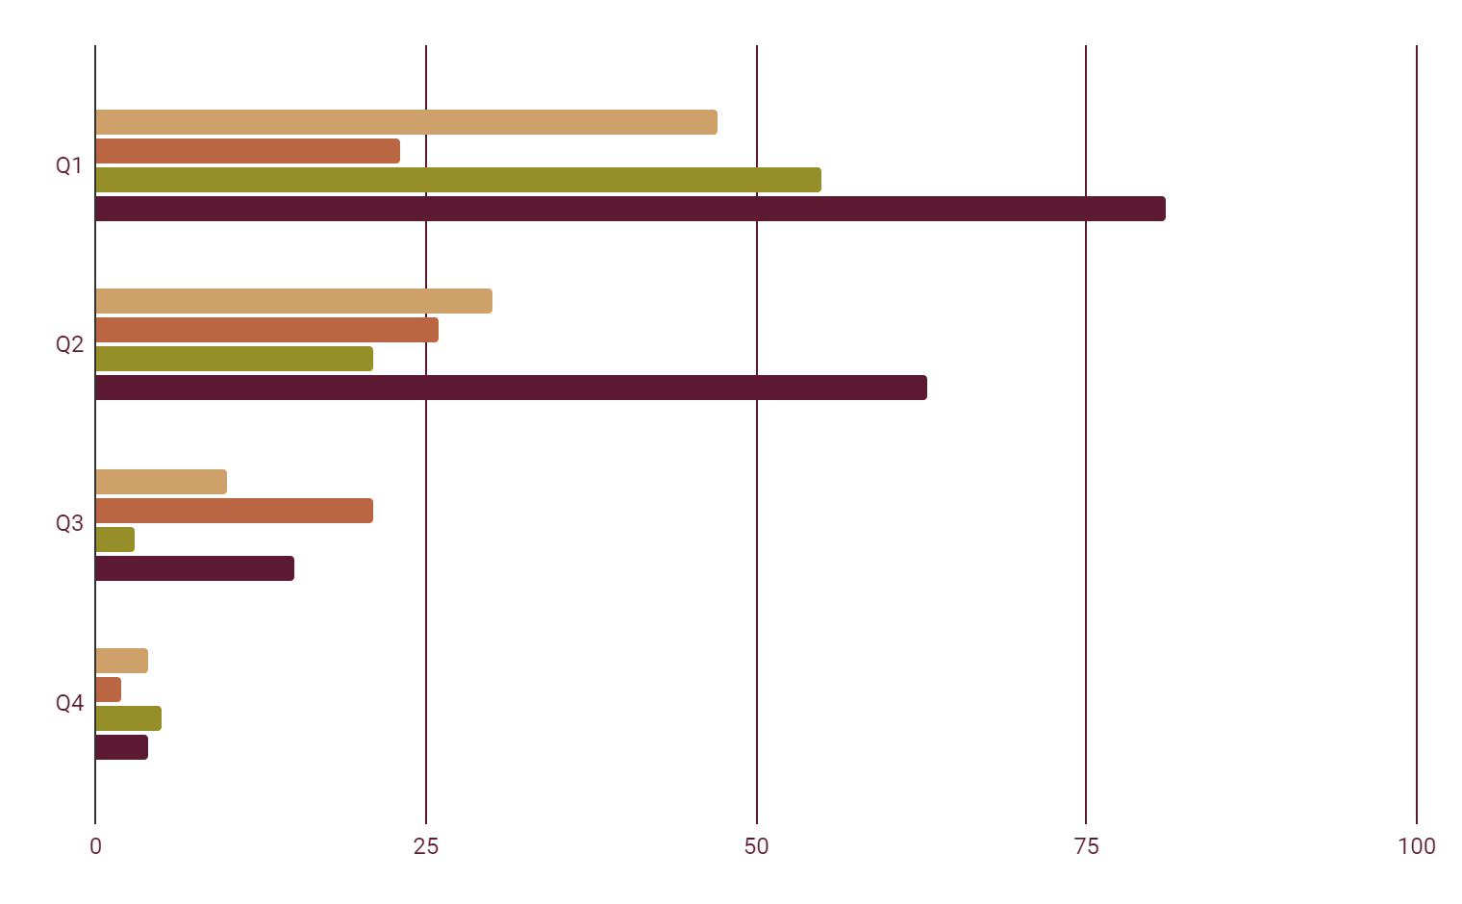
MONITORING FOR ONE YEAR
Mercury
Mars
Mercury is small
Mars is cold
Venus
Saturn
Venus is very hot
Saturn has rings
Follow the link in the graph to modify its data and then paste the new one here. For more info, click here

Slide 17
9h 55m 23s
333,000
386,000 km
Jupiter’s rotation period
The Sun’s mass compared to Earth’s
Distance between Earth and the Moon

Slide 18
TREATMENT ADVANCES
20%
30%
50%
Mercury
Venus
Mars
Mercury is the closest planet to the Sun and the smallest of them all
Venus has a beautiful name and is the second planet from the Sun
Despite being red, Mars is actually a cold place. It’s full of iron oxide dust

Slide 19
RESULTS
Do you know what helps you make your point crystal clear?
Lists like this one:
They’re simple
You can organize your ideas clearly
You’ll never forget to buy milk!
And the most important thing: the audience won’t miss the point of your presentation

Slide 20
CONTRAINDICATIONS & INDICATIONS
Contraindications
Indications
Describe the reasons to stop the treatment here
Describe the reasons to stop the treatment here
Describe the reasons to stop the treatment here
Describe the reasons to stop the treatment here
Describe the reasons to start the treatment here
Describe the reasons to start the treatment here
Describe the reasons to start the treatment here
Describe the reasons to start the treatment here

Slide 21
POST-PREVENTION
Mercury
Mars
Mercury is the smallest planet of them all
Despite being red, Mars is actually a cold place
Venus
Saturn
Venus is the second planet from the Sun
Saturn is composed of hydrogen and helium

Slide 22
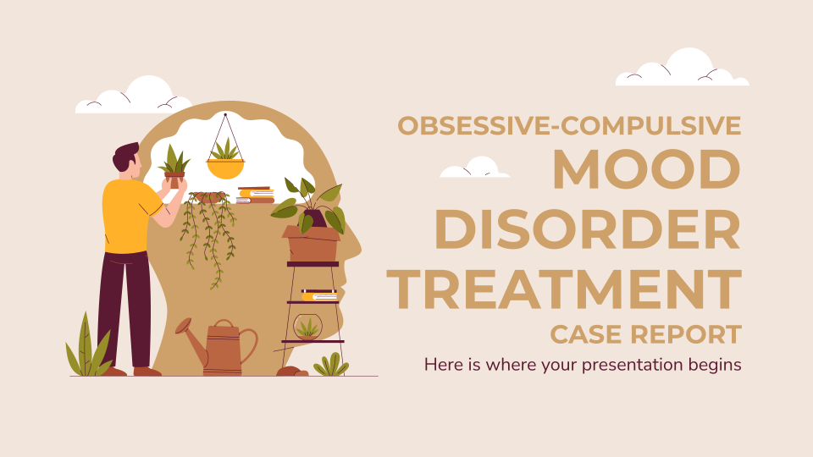
MOCKUP
You can replace the image on the screen with your own work. Just right-click on it and select “Replace image”

Slide 23
CASE TIMELINE
Venus
Mars
Jupiter
Venus is the second planet from the Sun
Despite being red, Mars is a cold place
Jupiter is the biggest planet of them all
1
2
3
4
5
Mercury
Saturn
Mercury is the closest planet to the Sun
Saturn is a gas giant and has several rings

Slide 24
CONCLUSIONS
Mercury is the closest planet to the Sun and the smallest one in the Solar System
Mercury’s name has nothing to do with the liquid metal, since Mercury was named after a Roman god
Venus has a beautiful name and is the second planet from the Sun. It’s terribly hot, even hotter than Mercury, and its atmosphere is extremely poisonous
Earth is the third planet from the Sun and the only one that harbors life in the Solar System

Slide 25
THANKS!
Do you have any questions?
youremail@freepik.com
+91 620 421 838
yourwebsite.com
Please keep this slide for attribution

